Slide 1
3D Image Segmentation and Quantification of Lysosomes
11/12/2025

Slide 2
Automatization(thresholding)
Sauvola:
https://scikit-image.org/docs/0.25.x/auto_examples/segmentation/plot_niblack_sauvola.html
Instead of calculating a single global threshold for the entire image, several thresholds are calculated for every pixel by using specific formulae that take into account the mean and standard deviation of the local neighborhood (defined by a window centered around the pixel).
  Variable illumination.
  Adaptive, locally computed.
  Automatically adapts to local brightness variations.
  Good for structures with bright centers and dim edges (like lysosomes)
Local mean
https://scikit-image.org/docs/0.25.x/auto_examples/applications/plot_thresholding_guide.html
Local mean thresholding is an adaptive image processing technique that sets a pixel's final black/white (binary) value based on the average pixel intensity (mean) within its surrounding local neighborhood, rather than a single global value. This method excels in images with uneven lighting or shadows by creating region-specific thresholds, making it ideal for text recognition and detailed surface analysis where global methods fail.
  Smooth, dim structures; stable segmentation.
  Computes the local average intensity.
  Good for smooth objects
  Good when you want to include low-intensity rims.

Slide 3
FILES
40A_UAS-TMEM1923x-HA x 71G10 40A MARCM_L3_1_Airy_010724
Airy scan_40A_UAS-TMEM-HA_CB_4h_1_051222

Slide 4
Airy scan_40A_UAS-TMEM-HA_CB_0h_1_051222

Slide 5
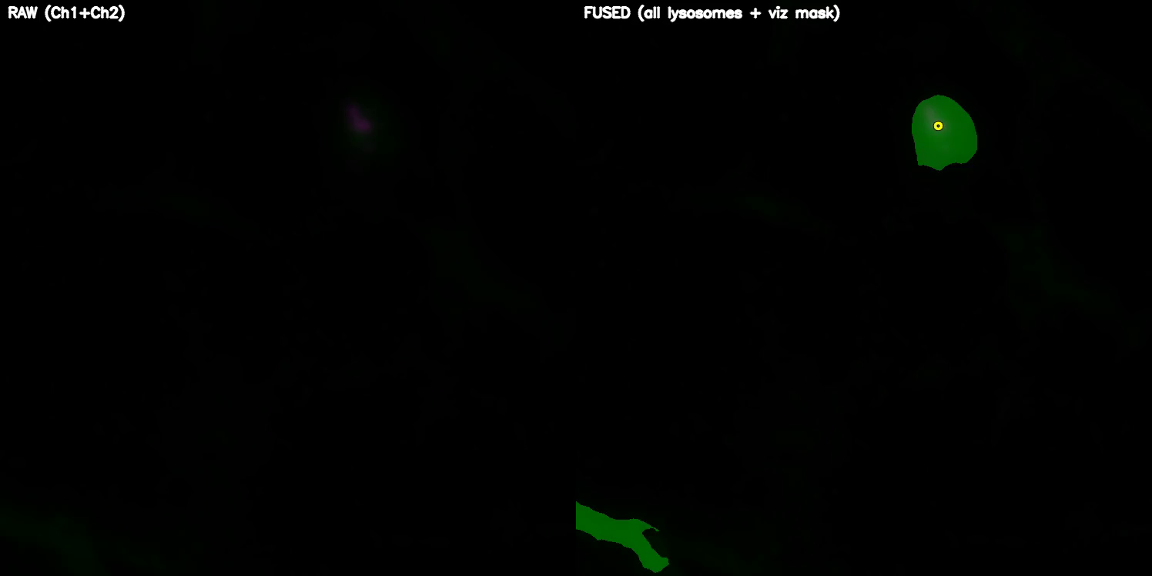
DETECTION VIDEO

Slide 6
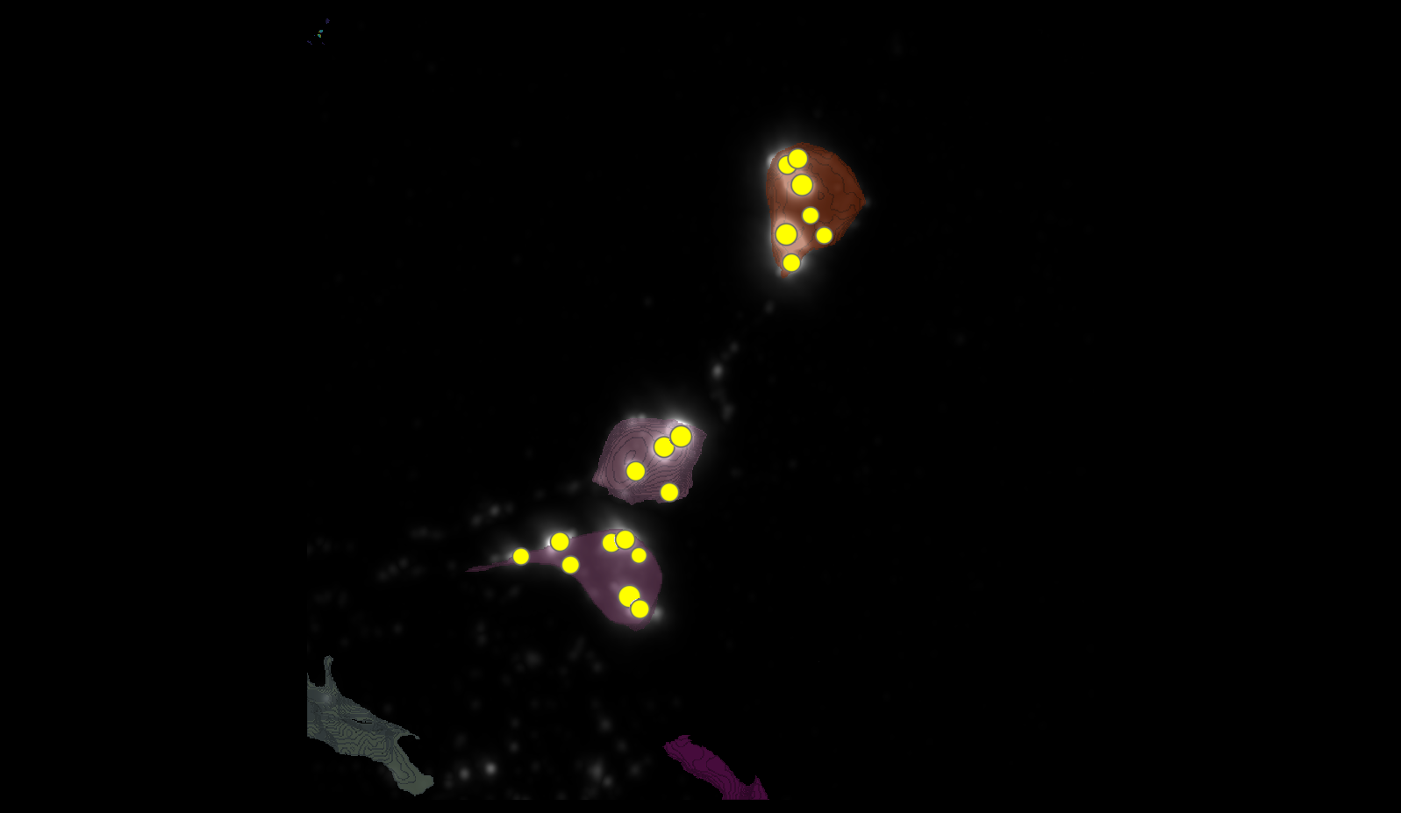
SEGMENTATION
1
3
5

Slide 7
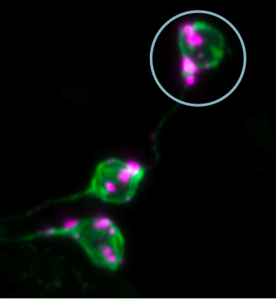
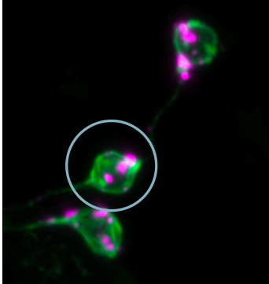
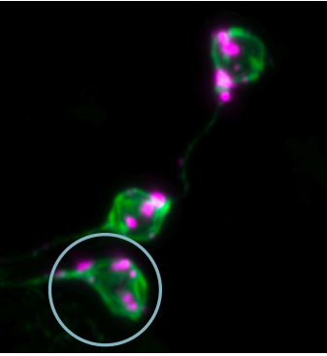
MANUAL.vs.AUTOMATIC
1
3
5

Slide 8




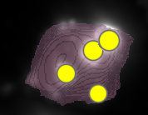
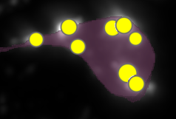







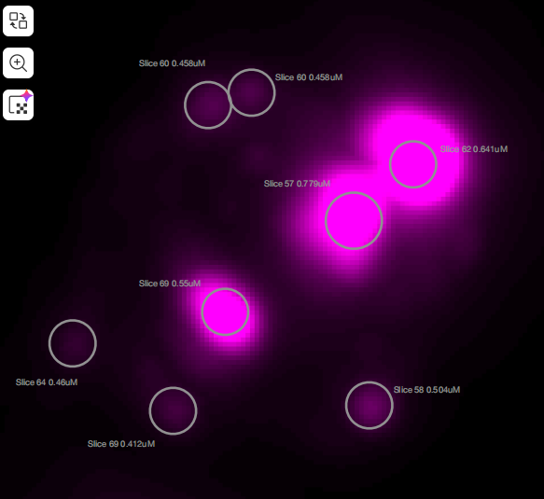

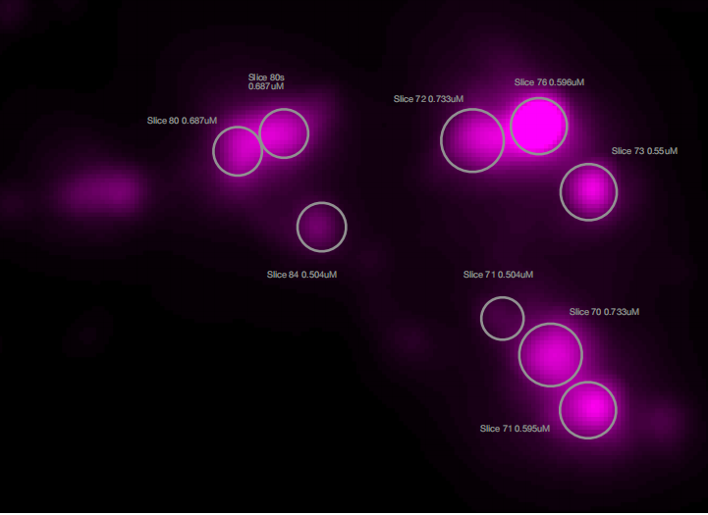
MANUAL.vs.AUTOMATIC
3
7
3
5
1
4
8
4
6
1
2
2

Slide 9


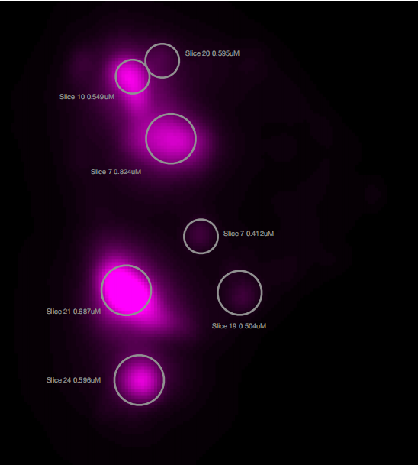






MANUAL.vs.AUTOMATIC
4
3
1
2
5
6
7

Slide 10
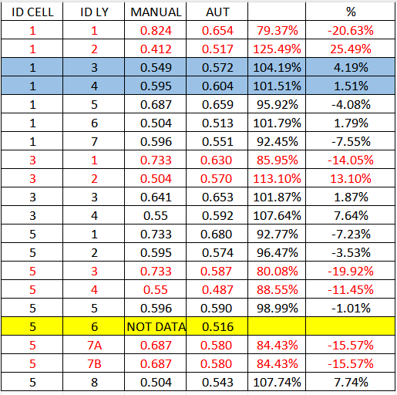
MANUAL.vs.AUTOMATIC
LYSOSOMES CHECK,
LAST MEETING

Slide 11
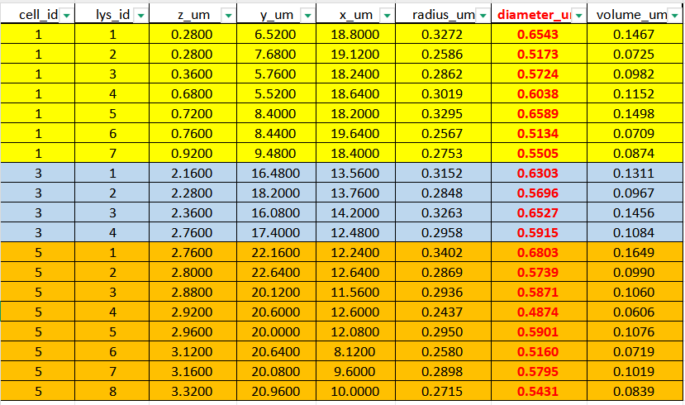

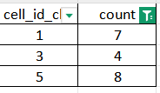

DATASETS

Slide 12
40A_UAS-TMEM1923x-HA x 71G10 40A MARCM_L3_1_Airy_010724

Slide 13
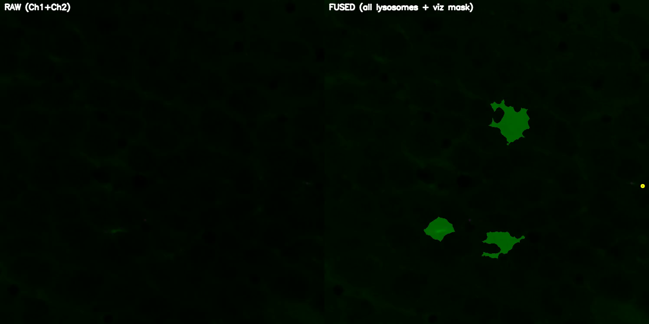
DETECTION VIDEO

Slide 14
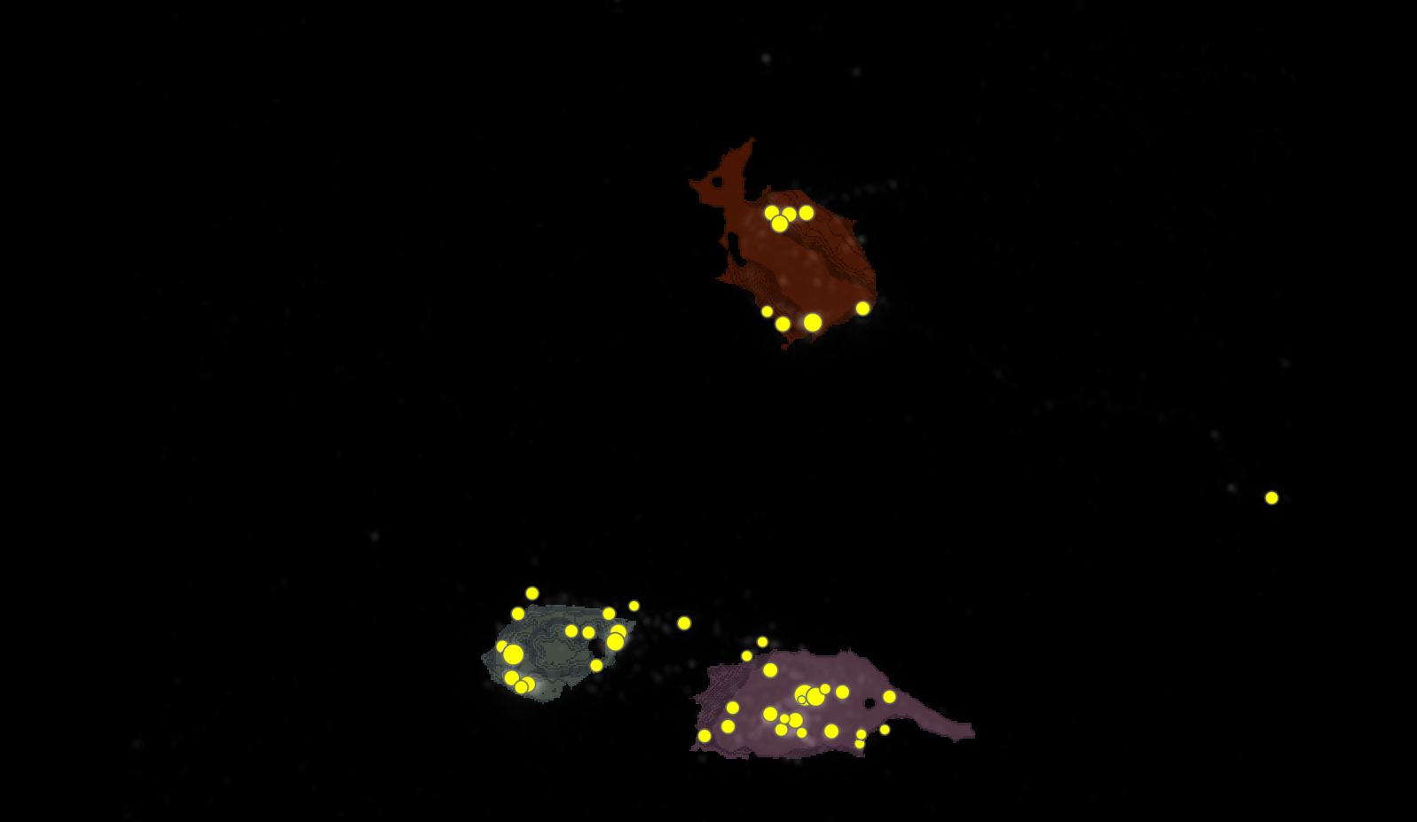




SEGMENTATION
1
2
3

Slide 15
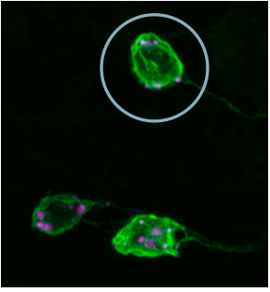
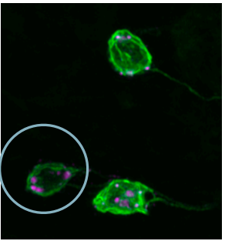
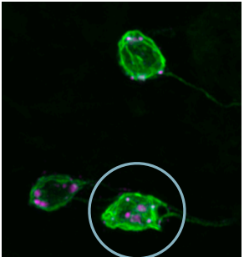
MANUAL.vs.AUTOMATIC
1
2
3

Slide 16

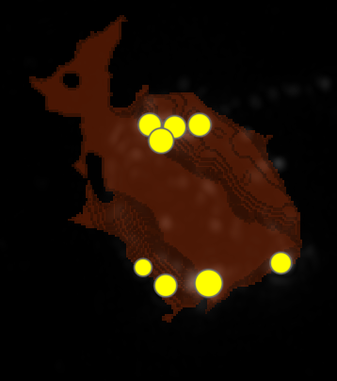



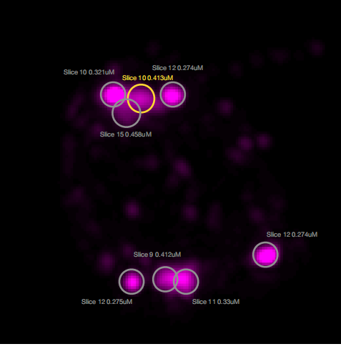




MANUAL.vs.AUTOMATIC
1
2
1
5
8
3
7
4

Slide 17
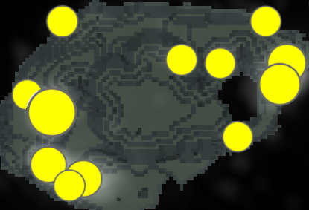








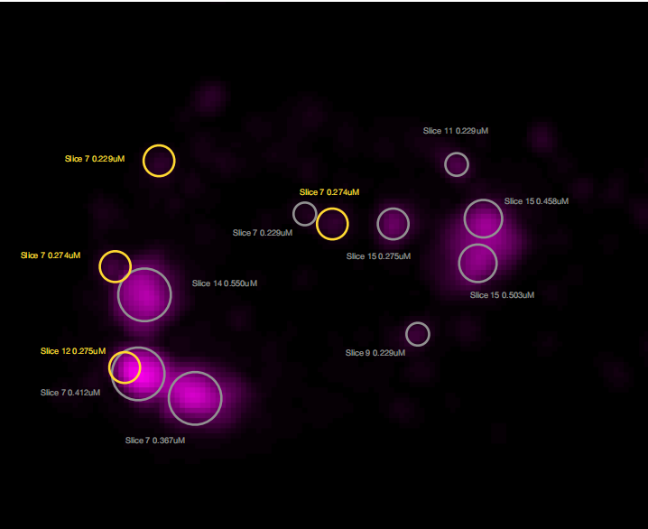




MANUAL.vs.AUTOMATIC
2
7
1
12
3
11
9
2
8
10
5
6
4

Slide 18
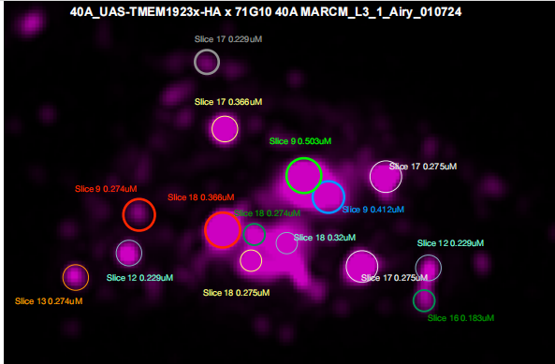



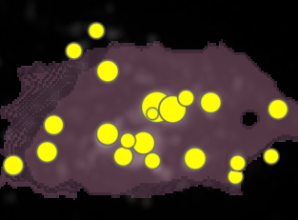



















MANUAL.vs.AUTOMATIC
17
10
3
16
8
11
2
1
3
5
13
18
19
12
9
7
LYSOSOMES CHECK,
LAST MEETING: CELL 3,
LY:9,13

Slide 19
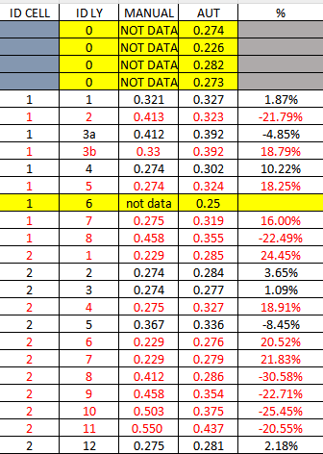
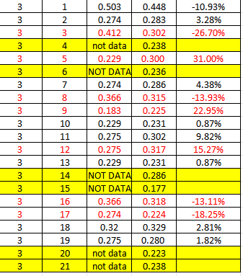
MANUAL.vs.AUTOMATIC
LYSOSOMES CHECK,
LAST MEETING: CELL 3,
LY:9,13

Slide 20
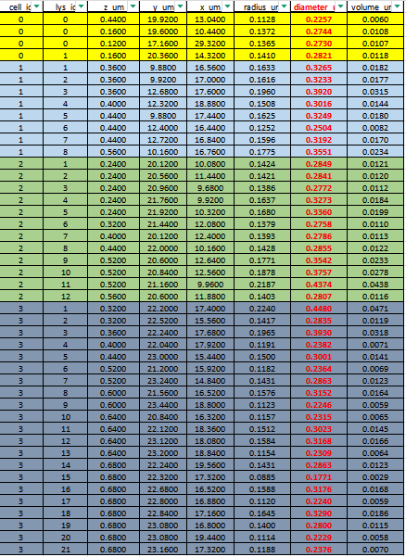

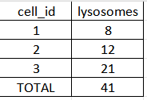

DATASET LYSOSOMES(ORDER FOR CELL ID)

